Slide 1
Demonstration of Website and Reporting Portal of UBA
Bharti Jasrotia
National Coordinating Institute
IIT Delhi

Slide 2
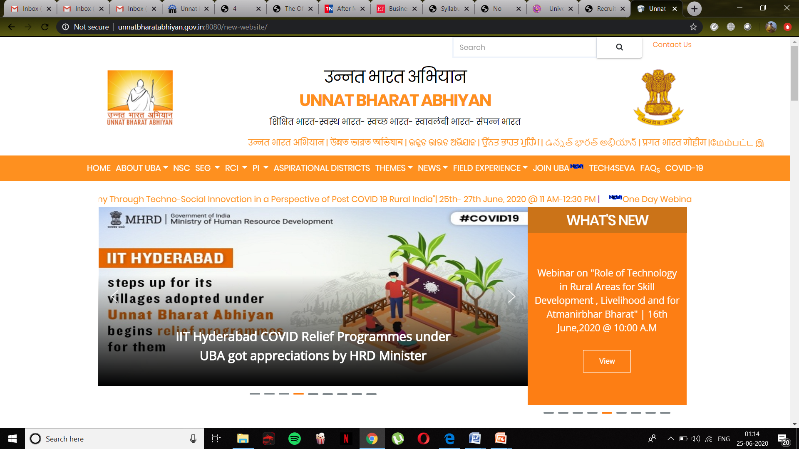
UBA Website

Slide 3
Purpose of website
Spreading our Vision & Mission to Increase Participation
Creating Awareness Among General Public
Easy Communication Between Stakeholders of the Abhiyan

Slide 4
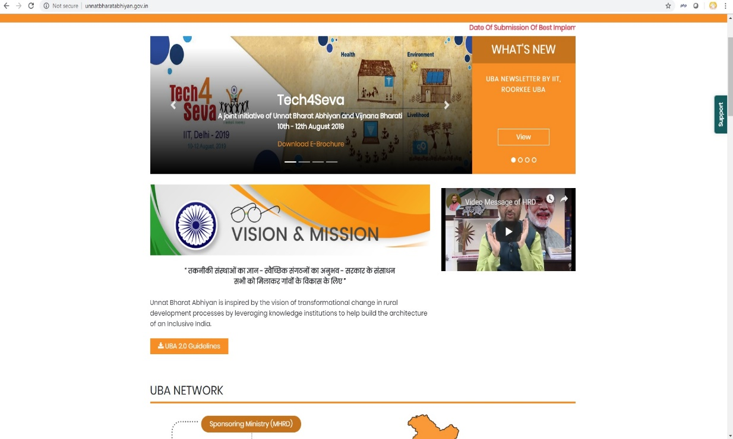
Features of Website
Interactive Map for Public Viewers
Field Experiences
Applications, Ranking, Selection List and Registration for Orientation: Join UBA
Monitoring of Participating Institutes: Reporting Portal

Slide 5
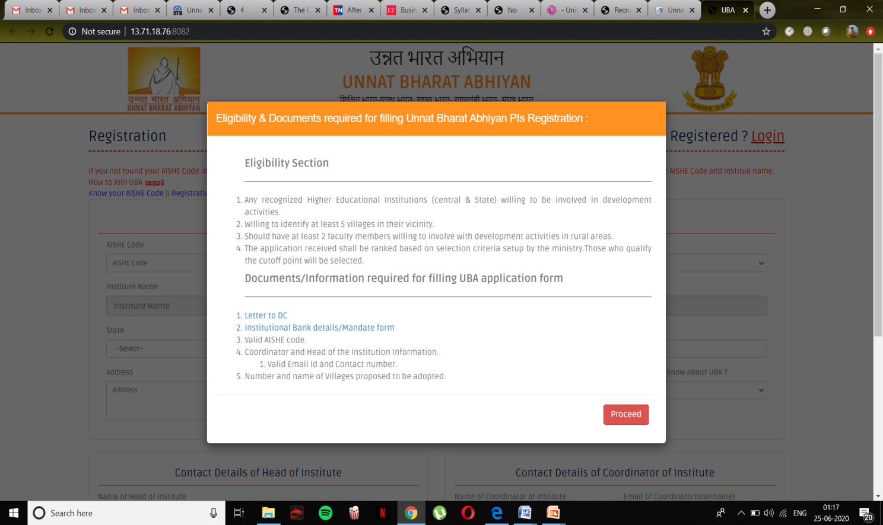
Join UBA
Read the eligibilty criteria and Download the templates for Letter to DC and Mandate form

Slide 6
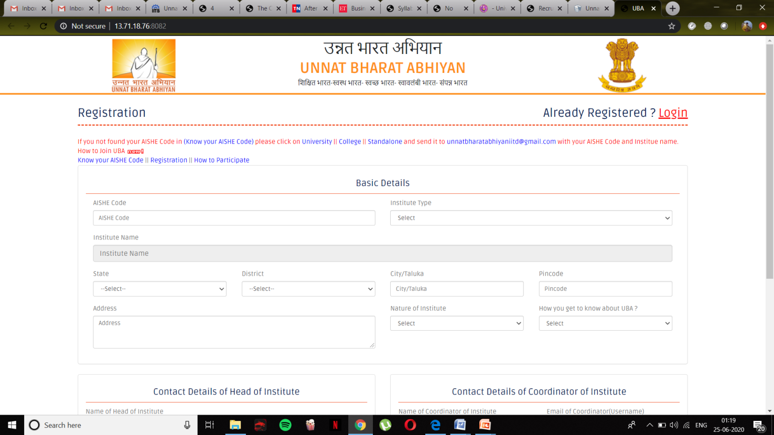
Join UBA
Fill all the required Data
Know your AISHE Code

Slide 7
Approval of Application
Once the application has been received, along with the required documents
Verification of the document is carried out in IIT Delhi.
After the verification process, a list of application is sent to MHRD for approvals.
After confirmation from MHRD, newly registered Participating Institution receives a welcome Kit from UBA (having all the relevant information) and the seed money of Rs. 50,000/- is being transferred to you Institutional Bank account.
PI will be mapped with their respective RCI and will be provided with Login credentials for their reporting portal.

Slide 8
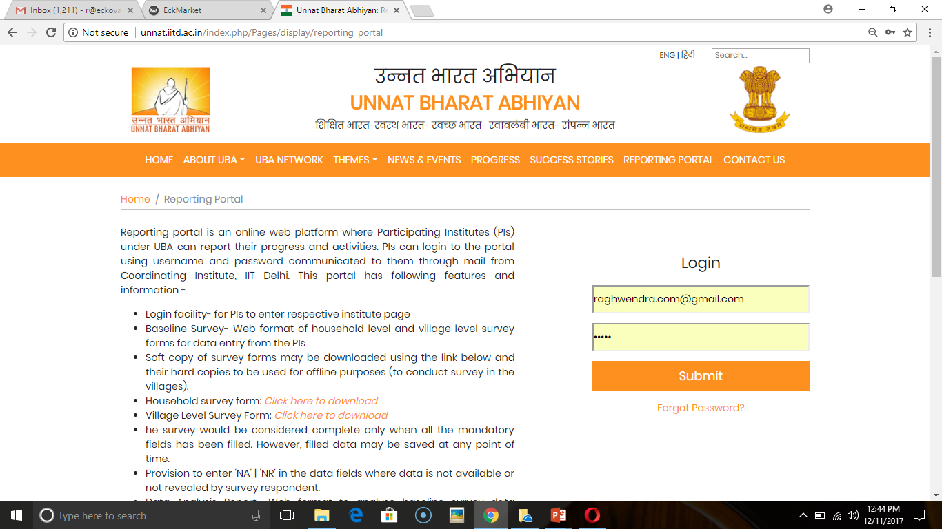
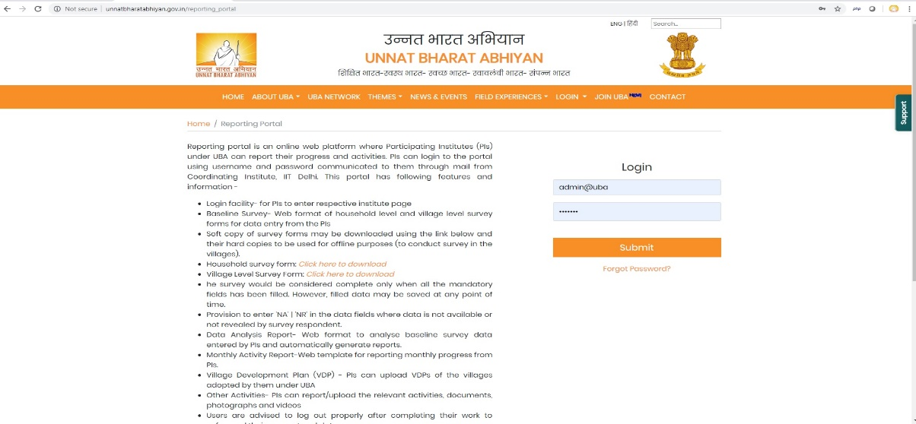
Reporting Portal
Village/Household Level Survey
Data Analysis Report
Plan of Action
Gram Panchayat Development Plan GPDP
Other Activities
SEG Portal

Slide 9
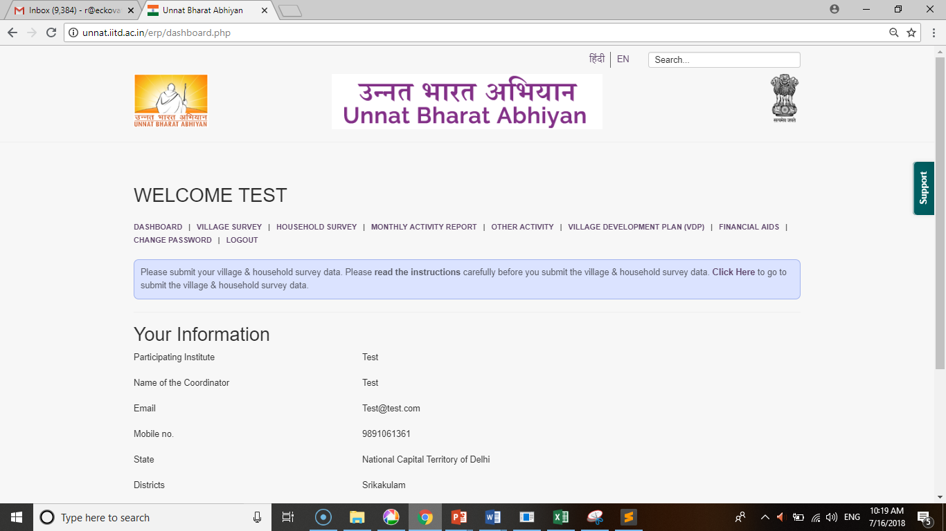
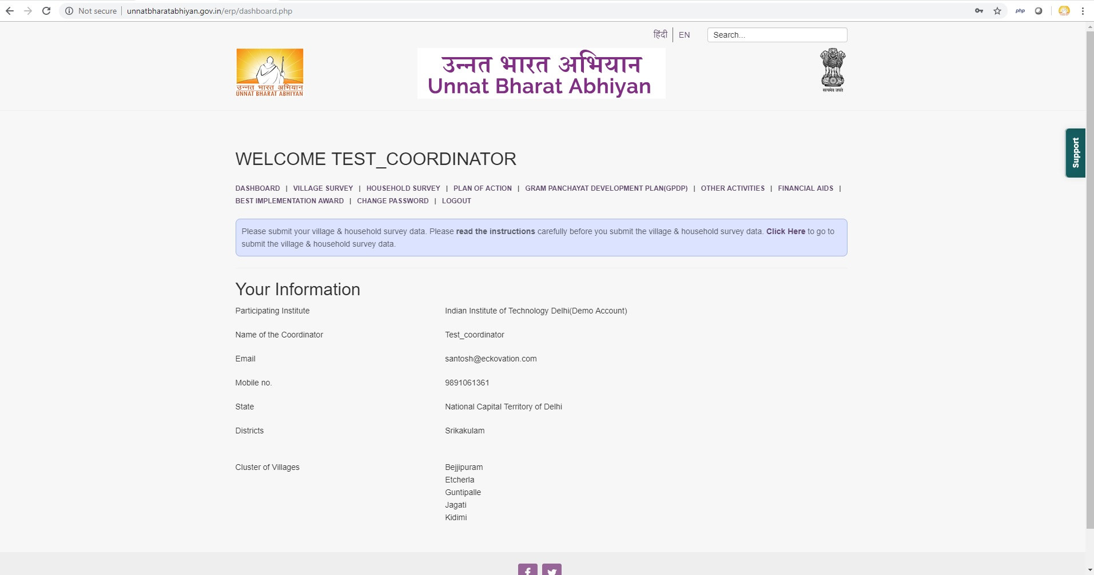
Reporting Portal

Slide 10
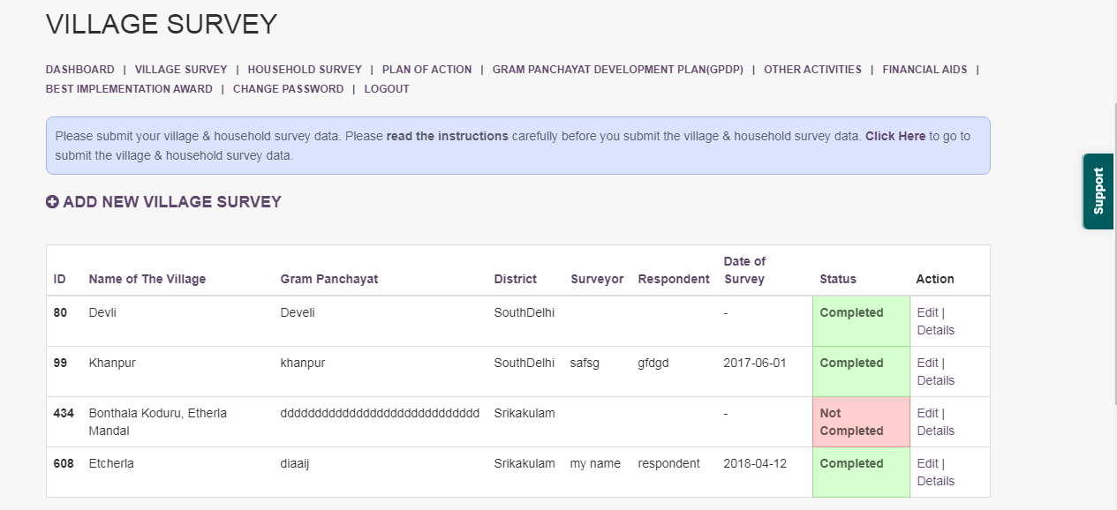
Reporting Portal

Slide 11
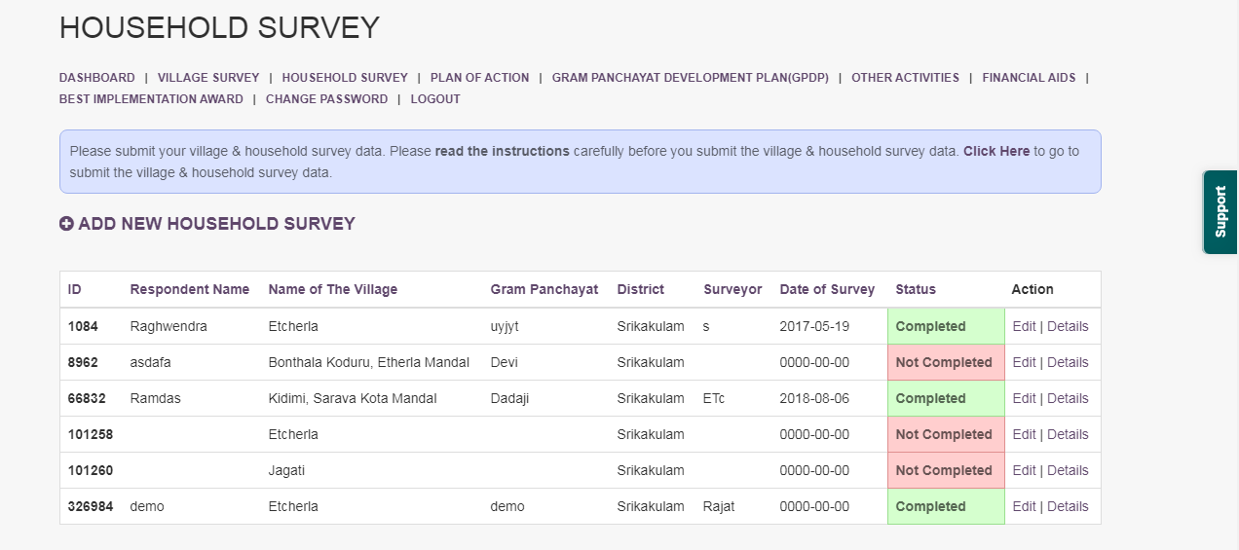
Reporting Portal

Slide 12
Reporting Portal
Village/Household Level Survey
Data Analysis Report
Plan of Action
Gram Panchayat Development Plan GPDP
Other Activities
SEG Portal

Slide 13
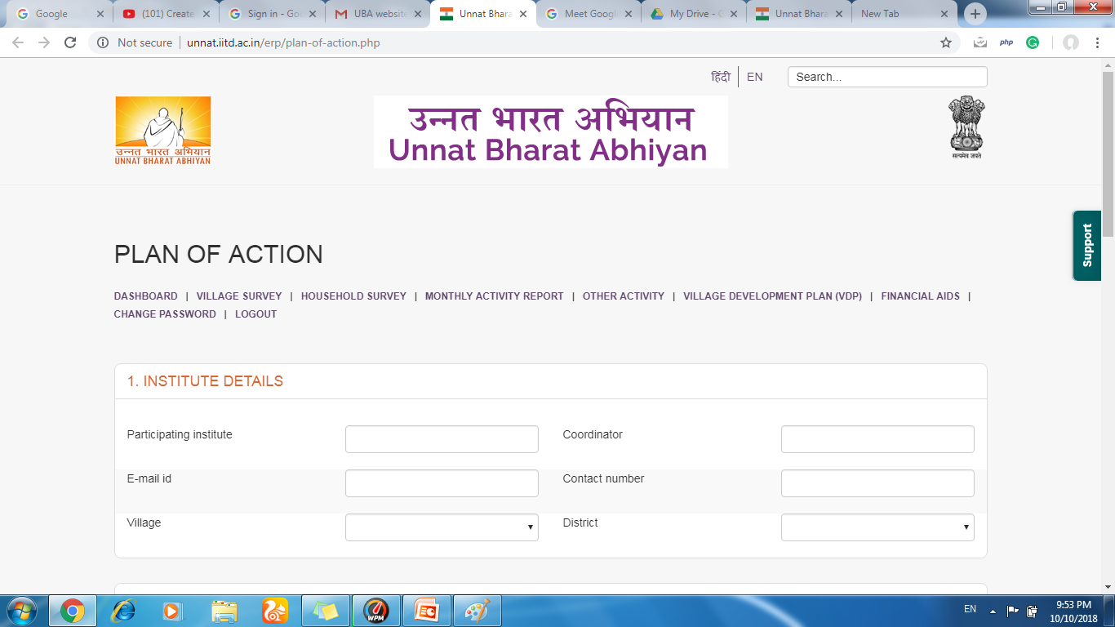
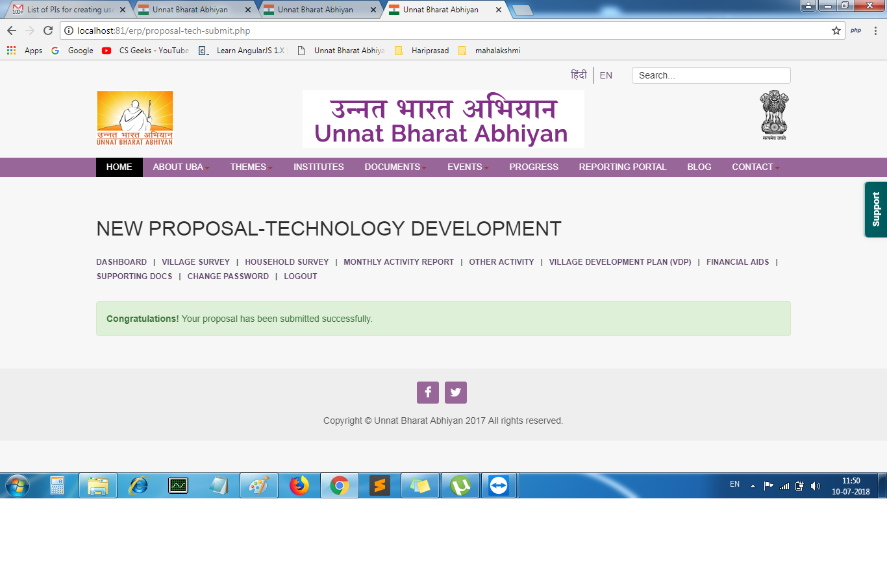
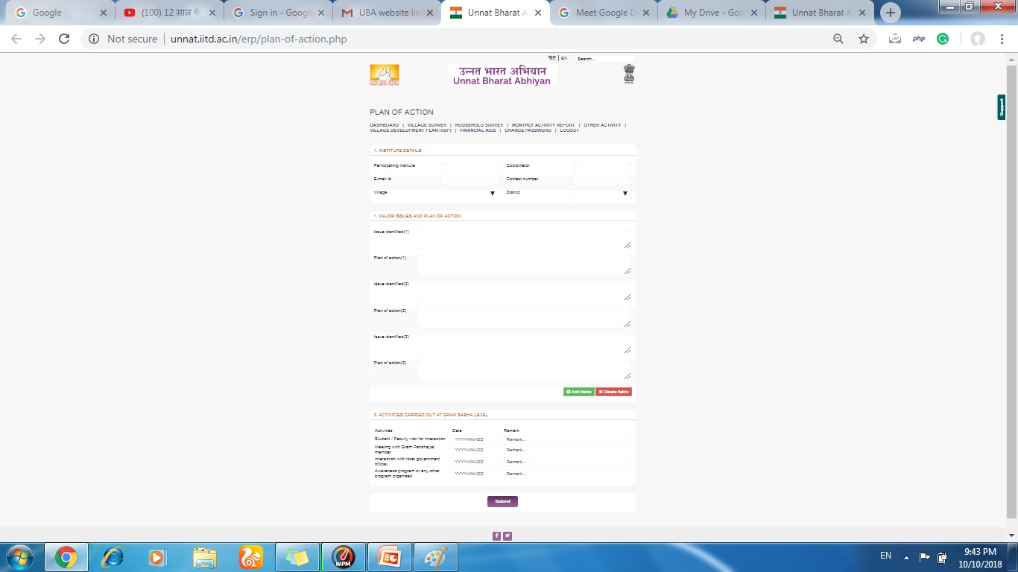
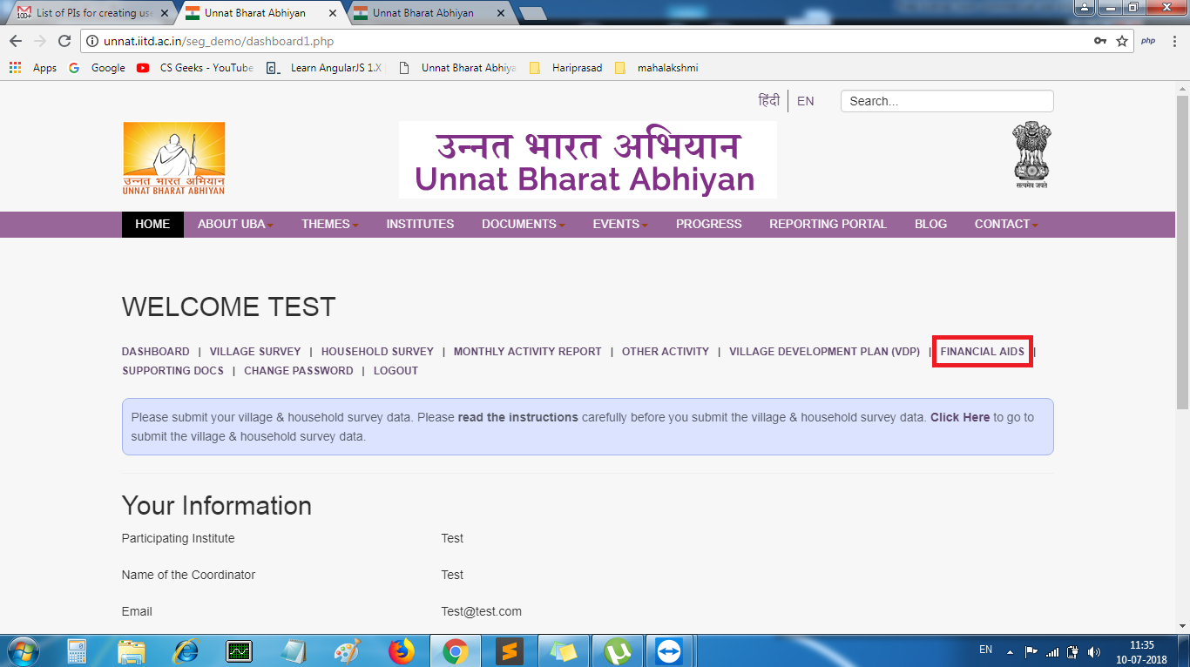
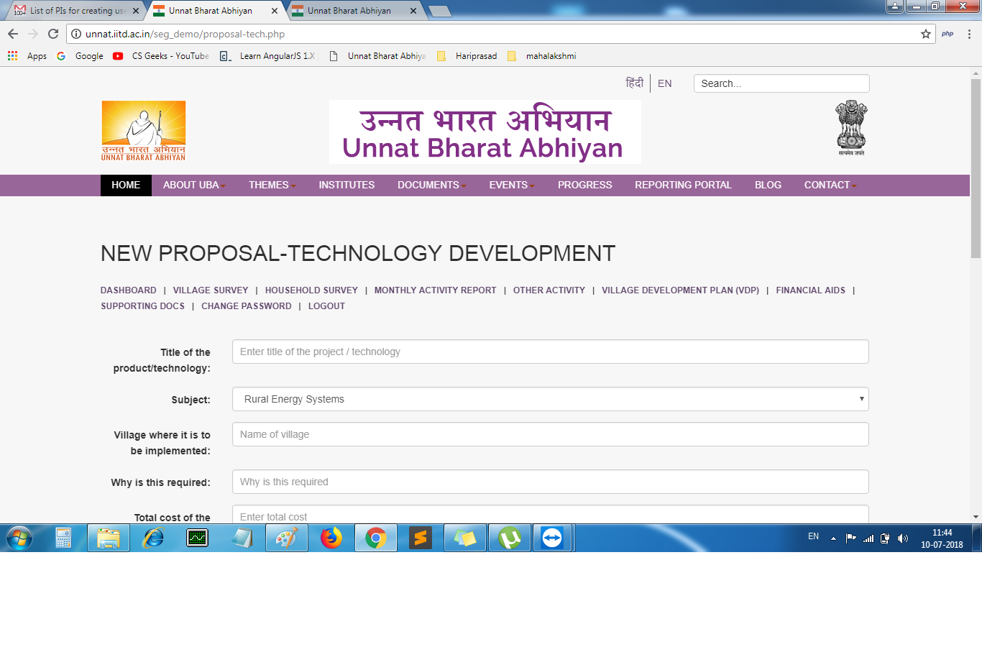
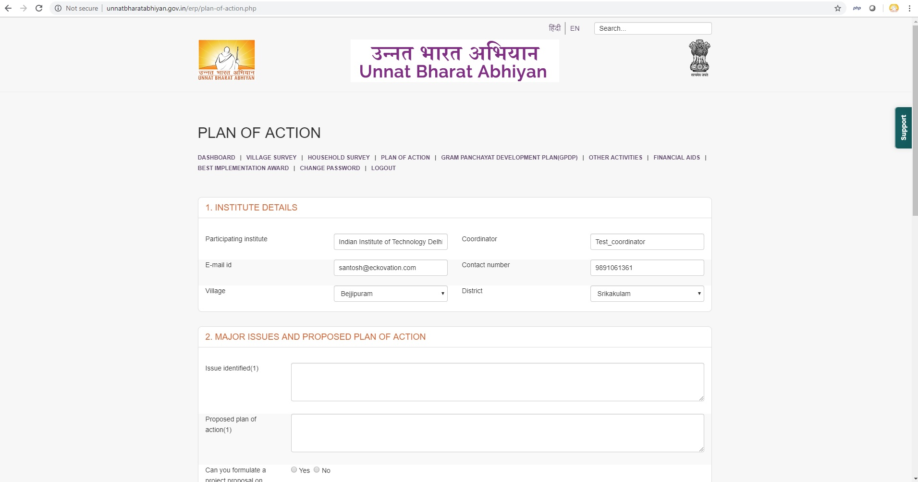

Slide 14
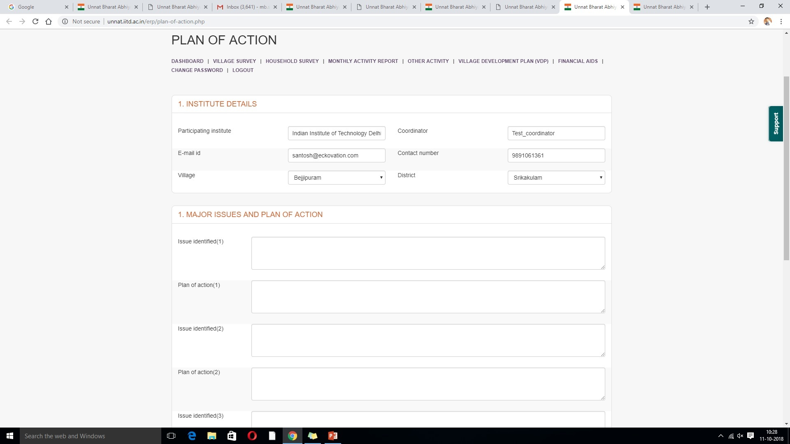
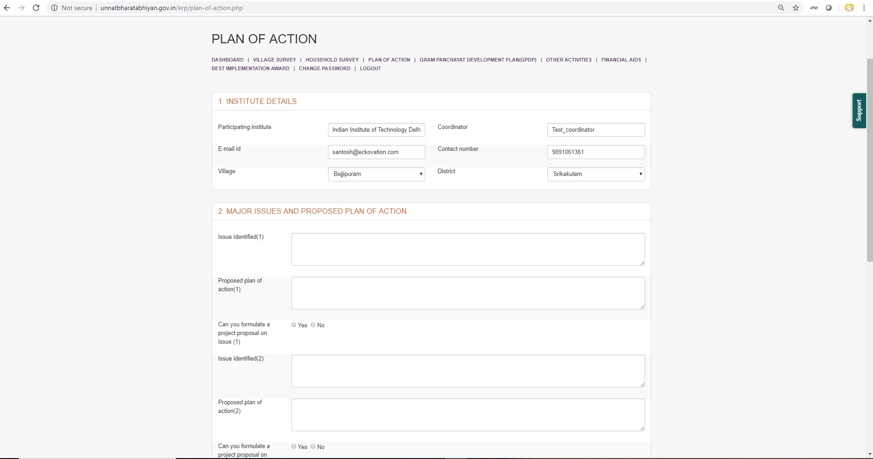

Slide 15
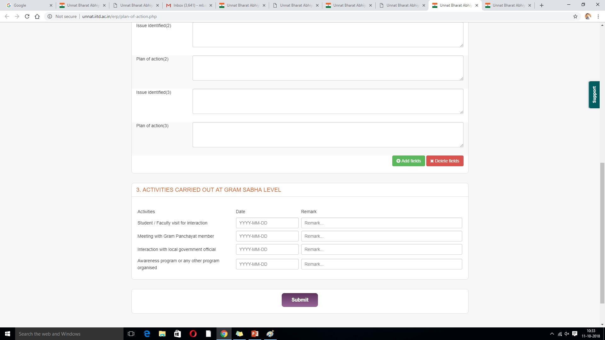

Slide 16
Reporting Portal
Village/Household Level Survey
Data Analysis Report
Plan of Action
Gram Panchayat Development Plan GPDP
Other Activities
SEG Portal

Slide 17
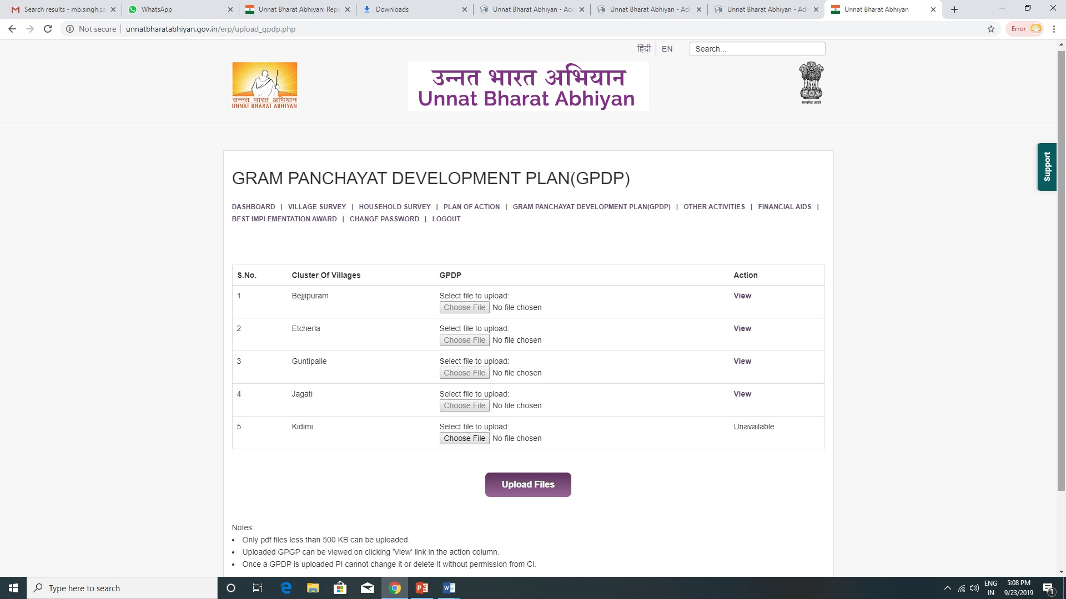

Slide 18
Reporting Portal
Village/Household Level Survey
Data Analysis Report
Plan of Action
Gram Panchayat Development Plan GPDP
Other Activities
SEG Portal

Slide 19
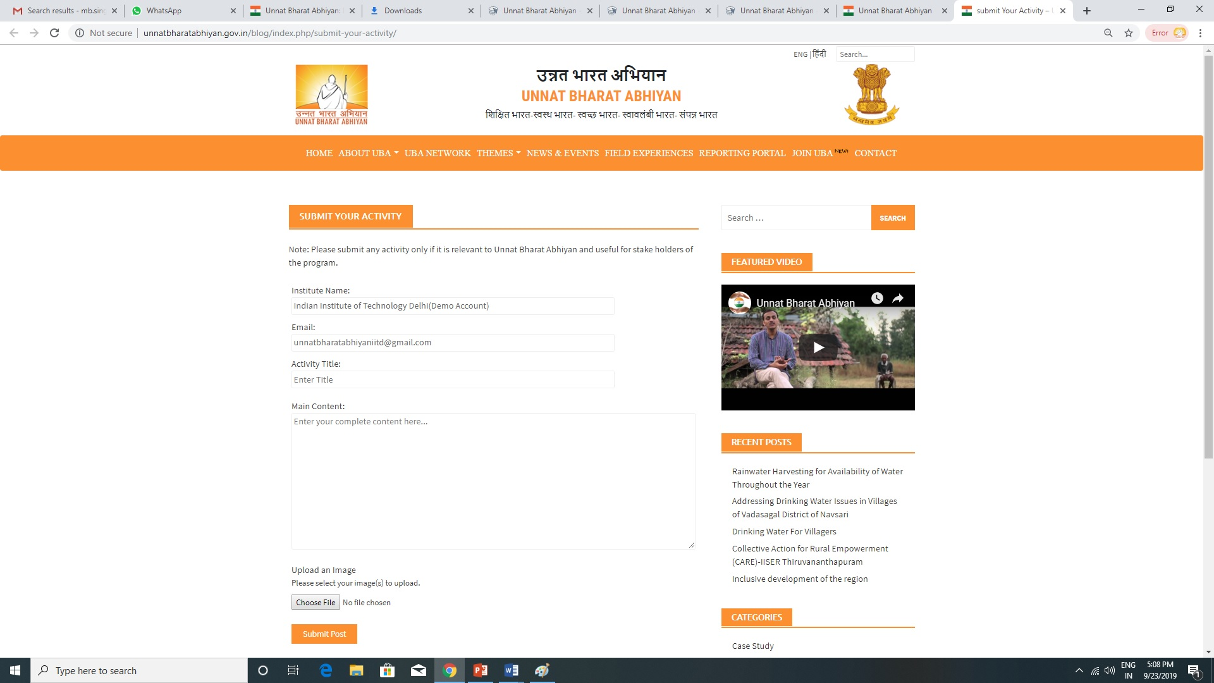

Slide 20
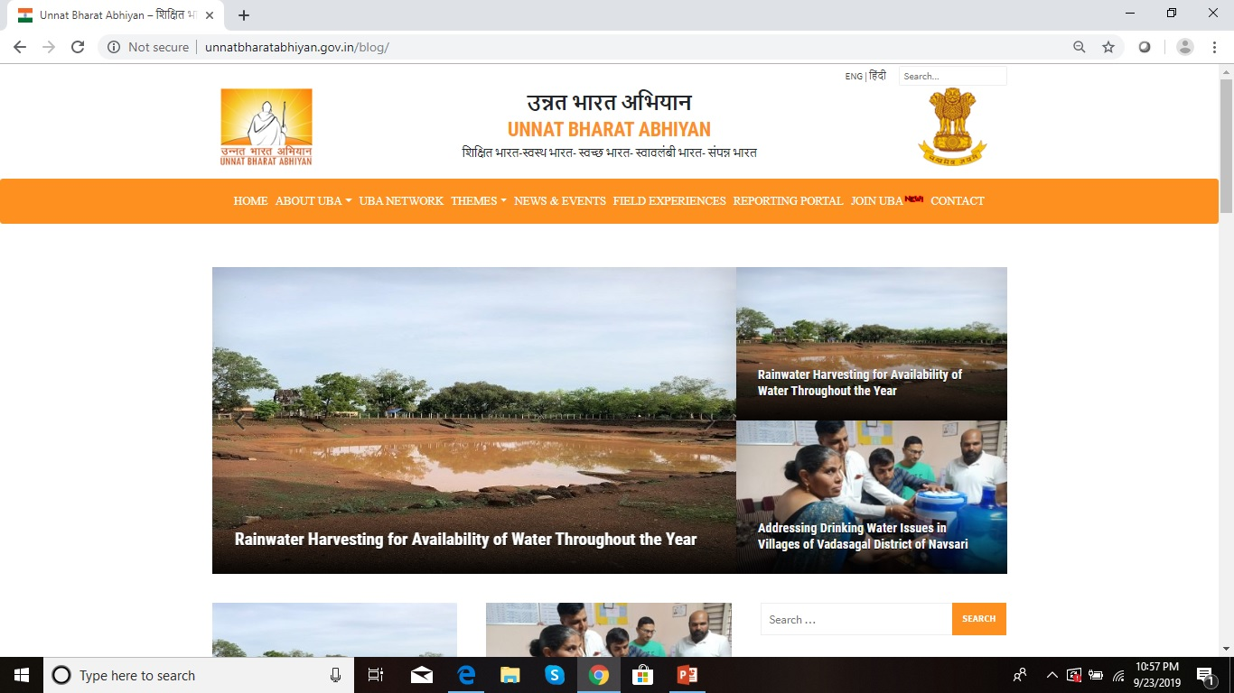

Slide 21
Reporting Portal
Village/Household Level Survey
Data Analysis Report
Plan of Action
Gram Panchayat Development Plan GPDP
Other Activities
SEG Portal

Slide 22
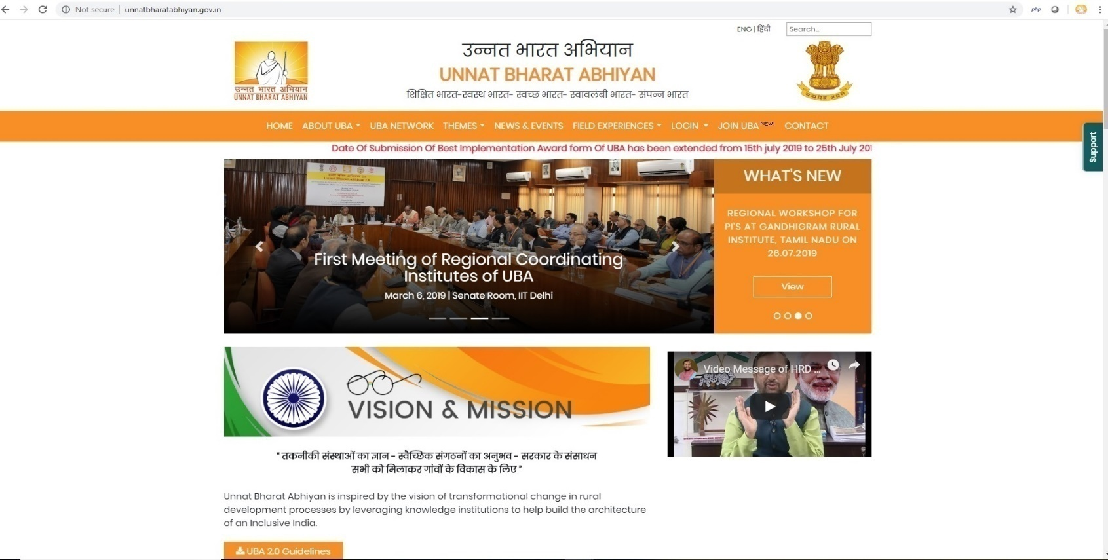
Strong Support System
Quick Support
Button

Slide 23
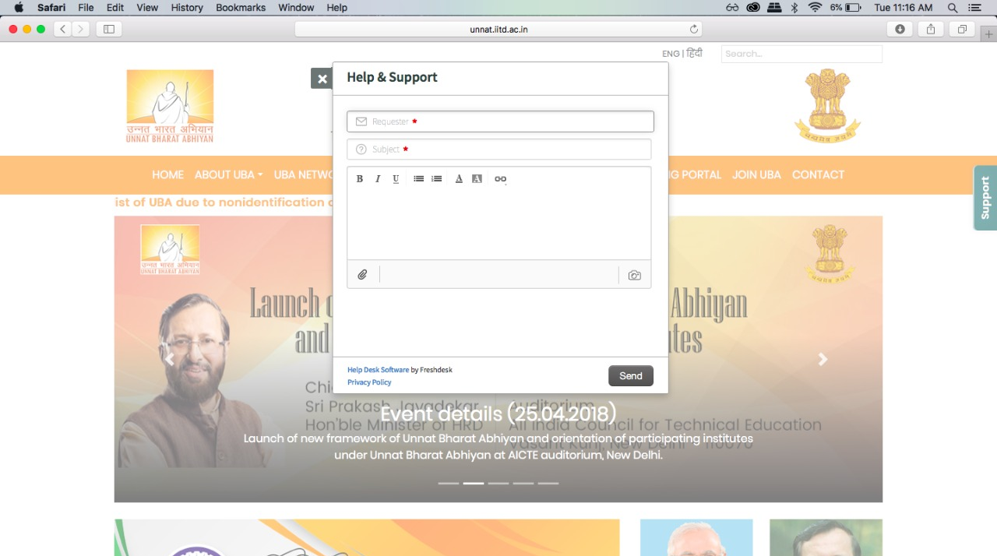
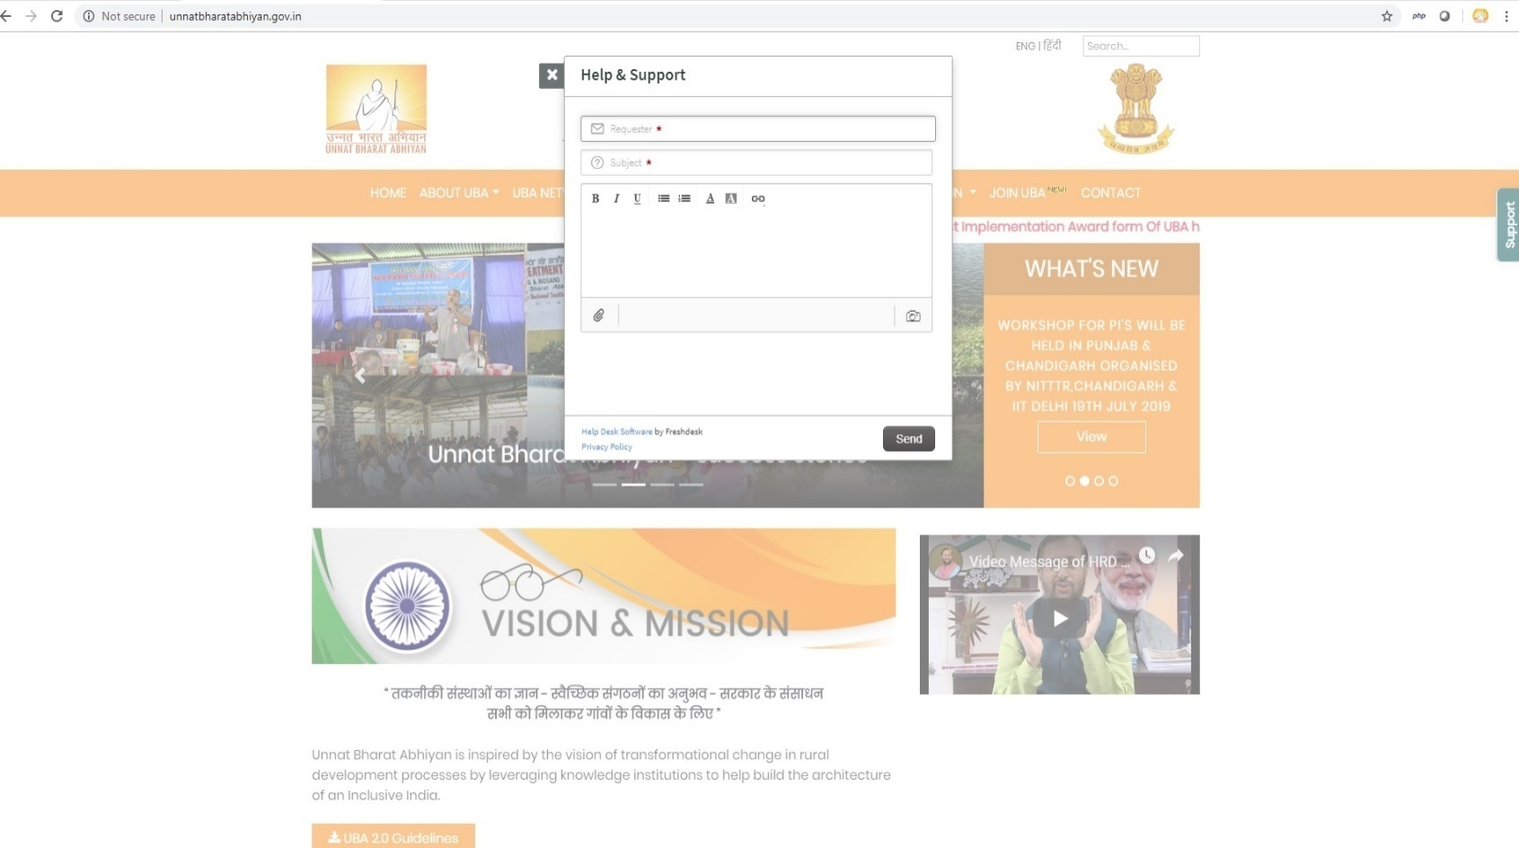
Strong Support System
No need to send email, just write the query and get quick response from the UBA team

Slide 24
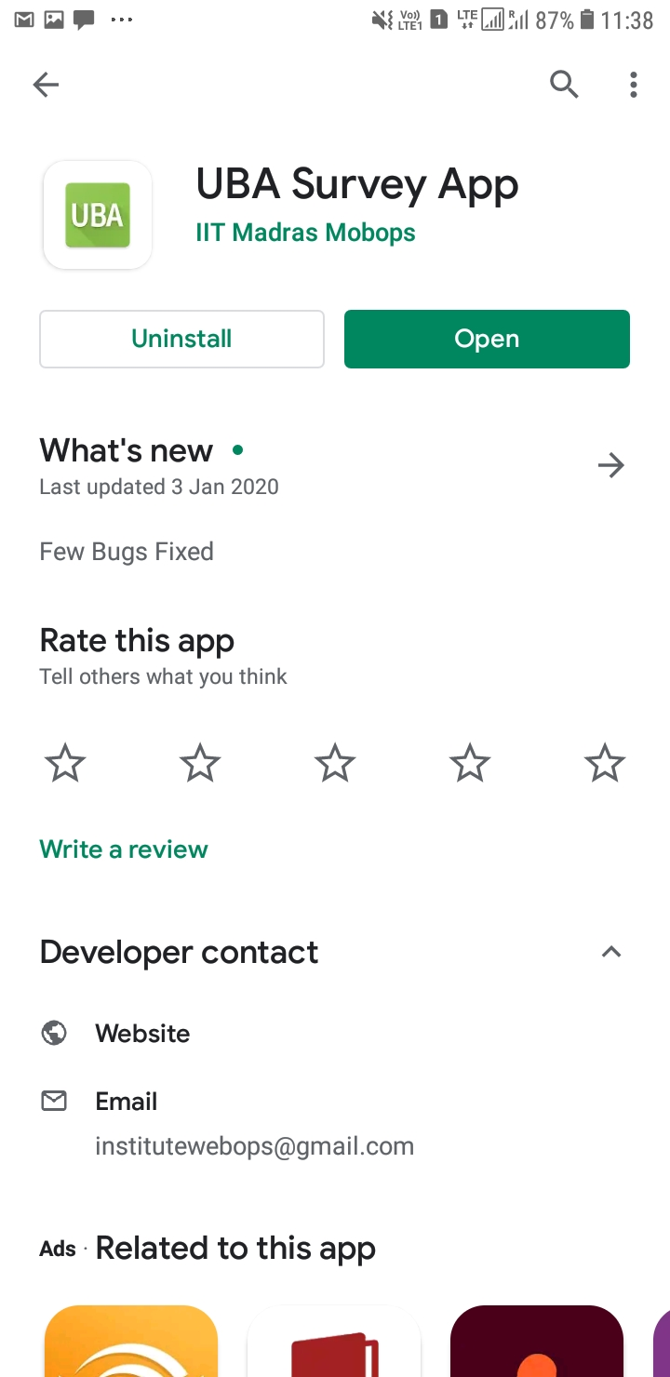
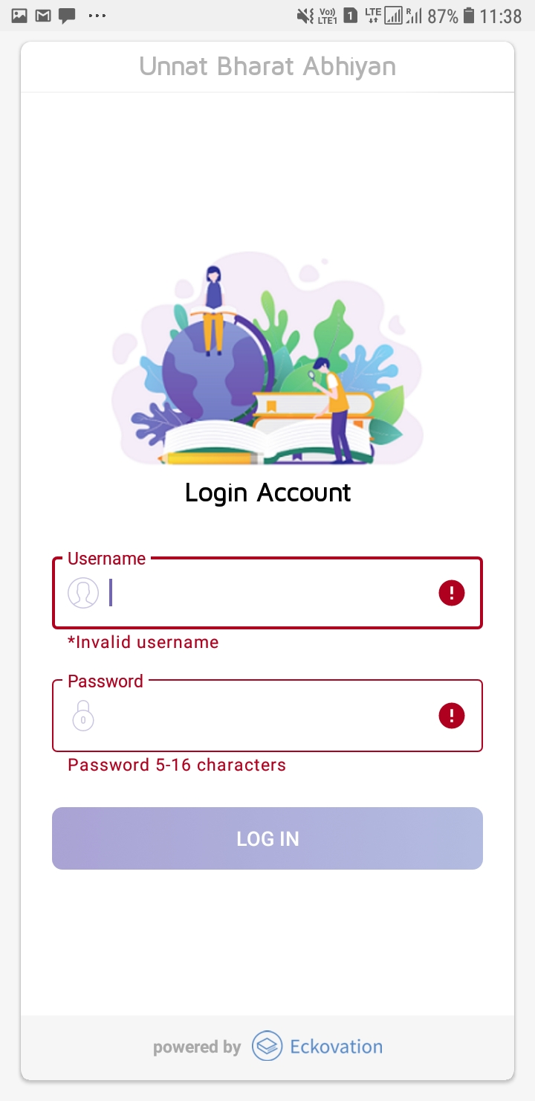
UBA Survey App

Slide 25
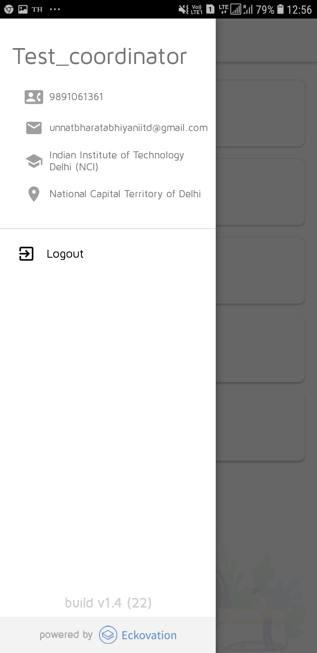
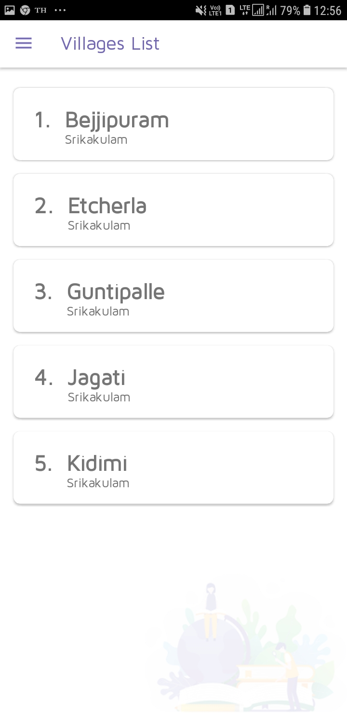
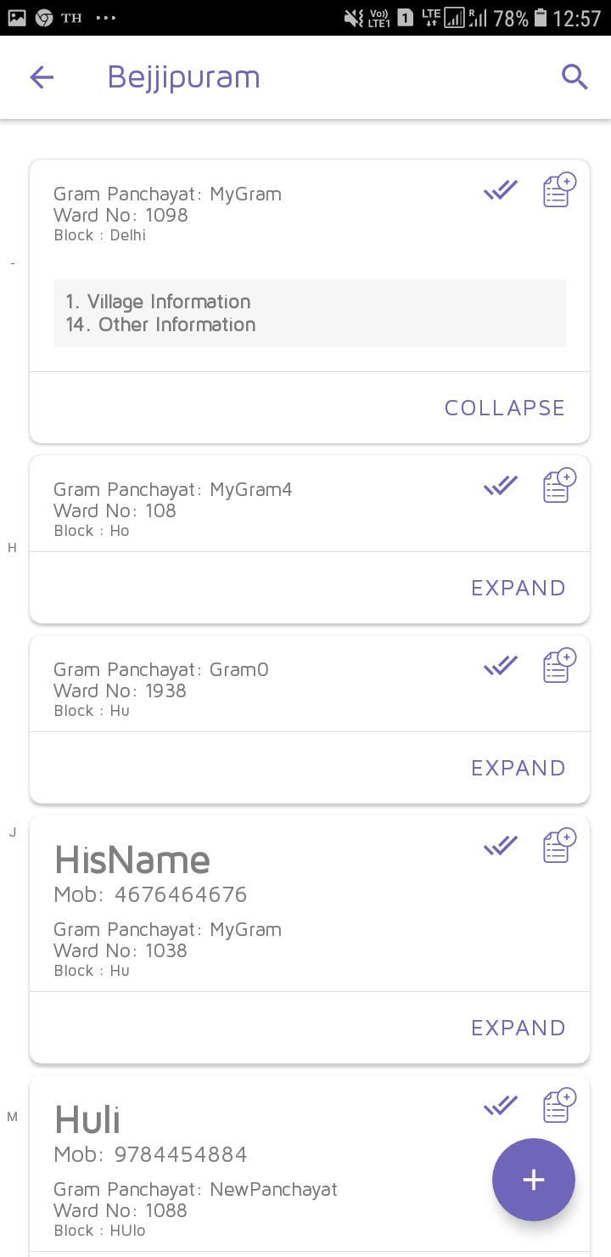
UBA Survey App

Slide 26
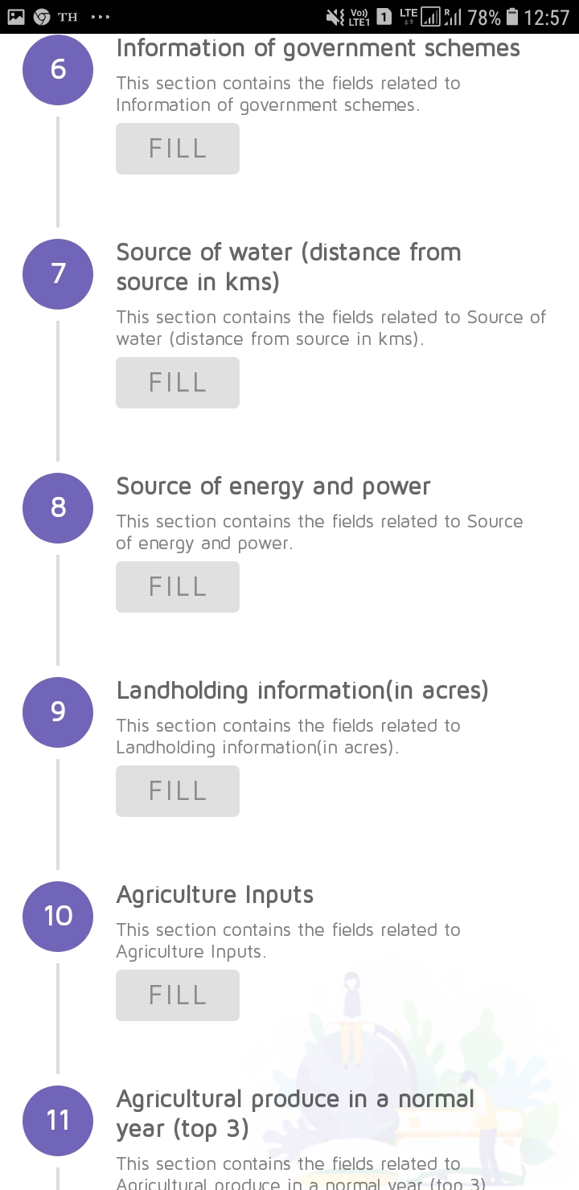
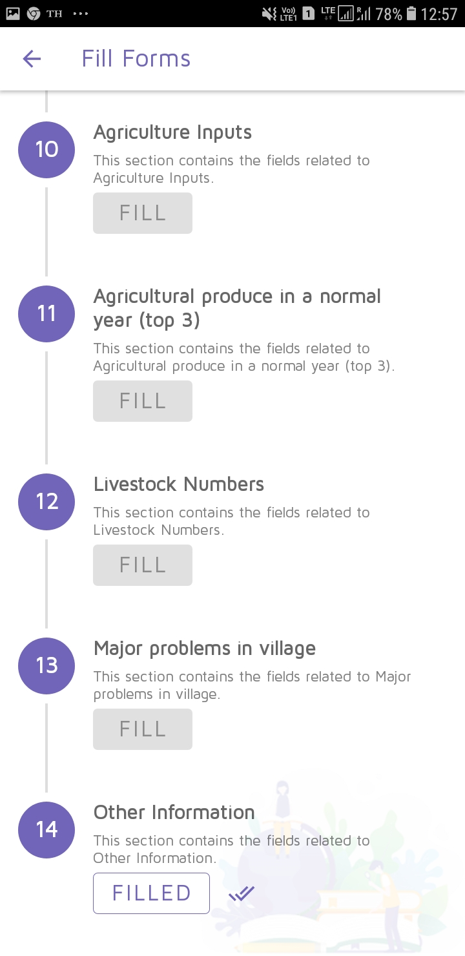
UBA Survey App

Slide 27
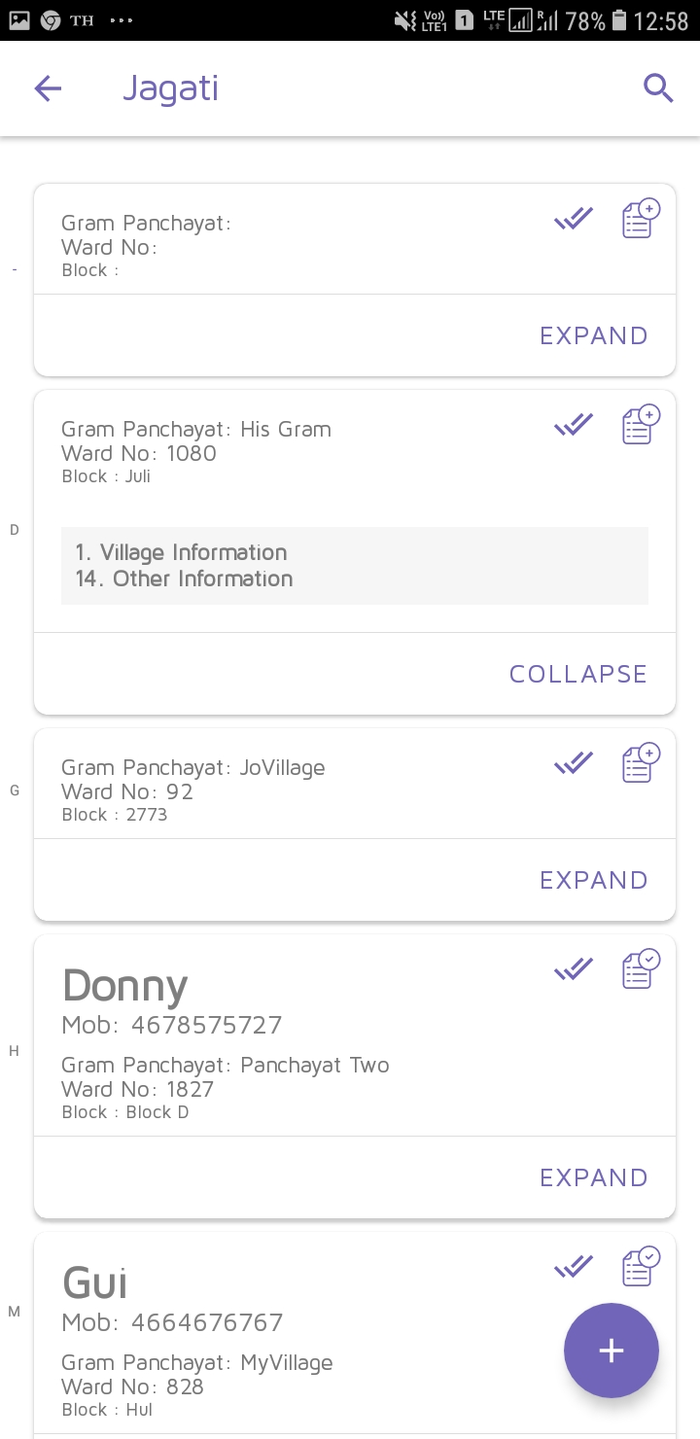
UBA Survey App

Slide 28
Website : https://unnatbharatabhiyan.gov.in
UBA Survey App:https://play.google.com/store/apps/details?id=in.ac.iitm.students.unnatbharatabhiyan

Slide 29
Thank You
Contact Us
unnatbharatabhiyaniitd@gmail.com
011-26596351/6451

